Slide 1

SESSION-4:
IAM

Slide 2
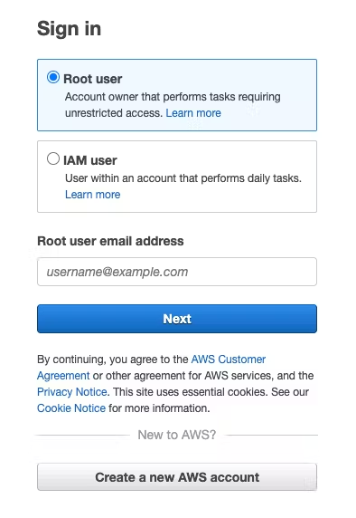
AWS Root User
It has full access to all AWS resources.
It shouldn’t be used for day-to-day interactions with AWS.

Slide 3
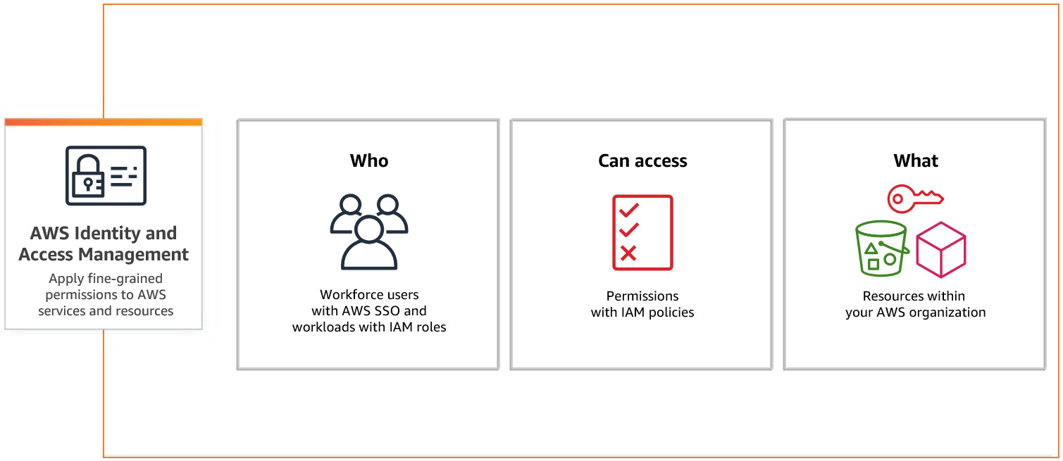
AWS Identity and Access Management (IAM)
Create and manage users, groups and roles.
Manage access to AWS resources and services.

Slide 4
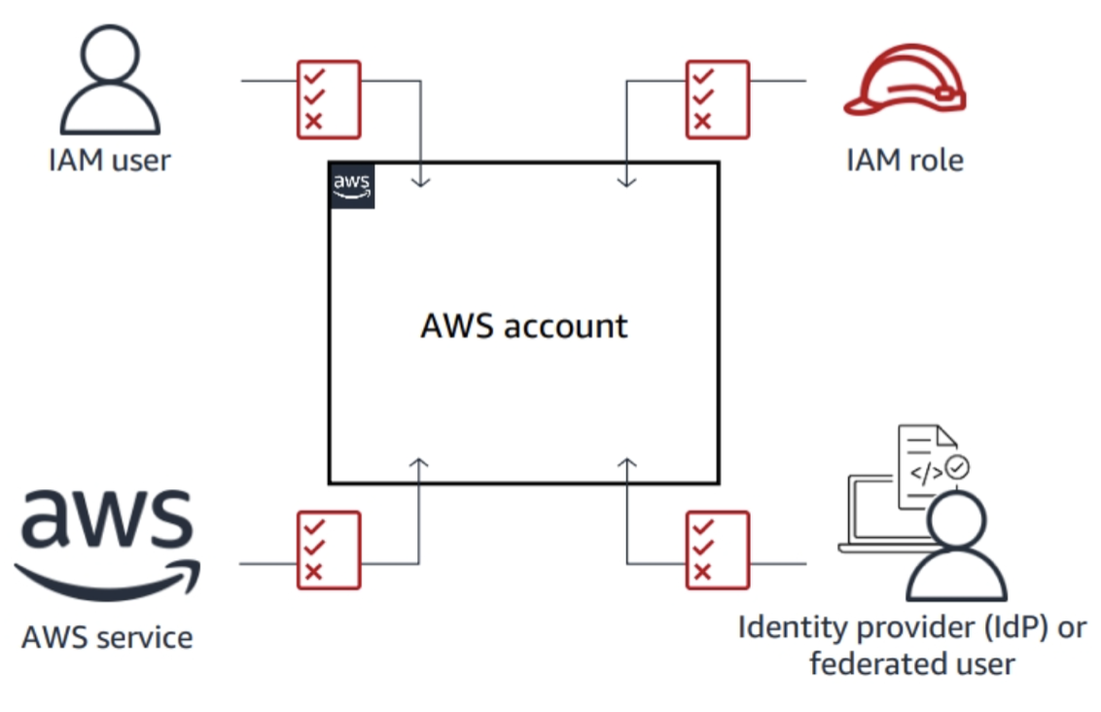
Principal
It can make a request for an action or operation on an AWS resource.
It can be a person, application, assumed role or federated user.

Slide 5
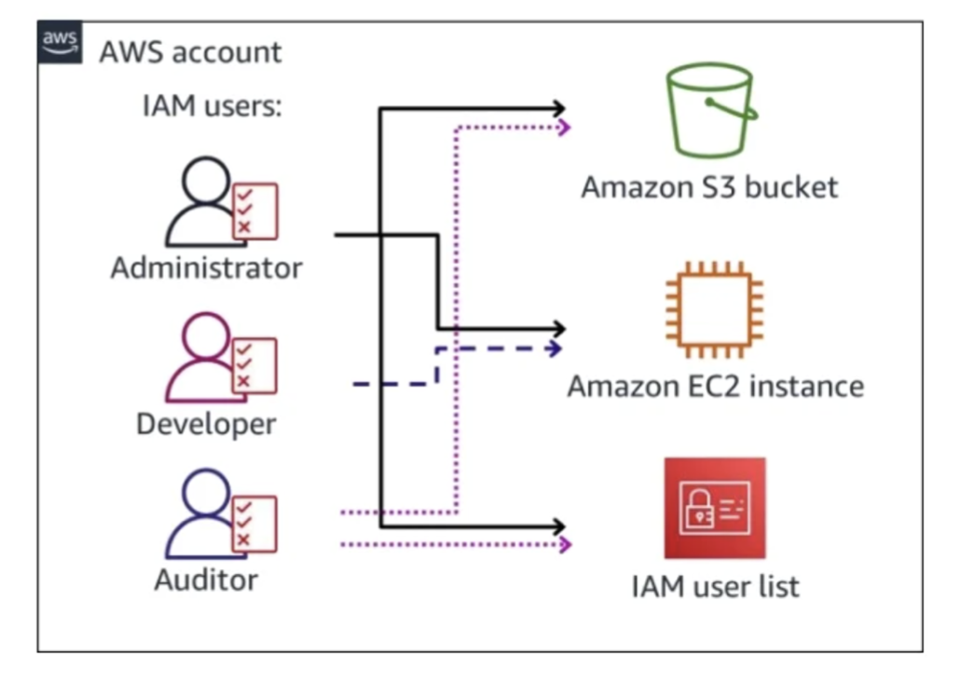
IAM Users
They are users in the AWS account, each have different credential.
They are able to perform specific AWS actions based on permissions.

Slide 6
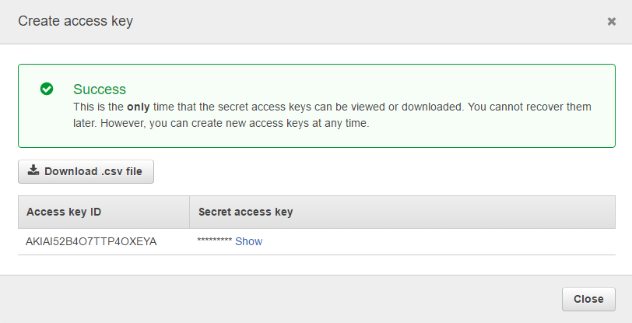
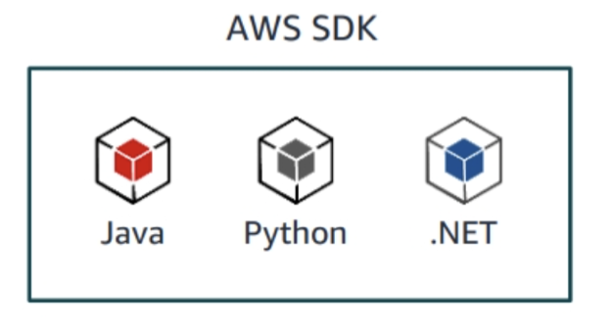
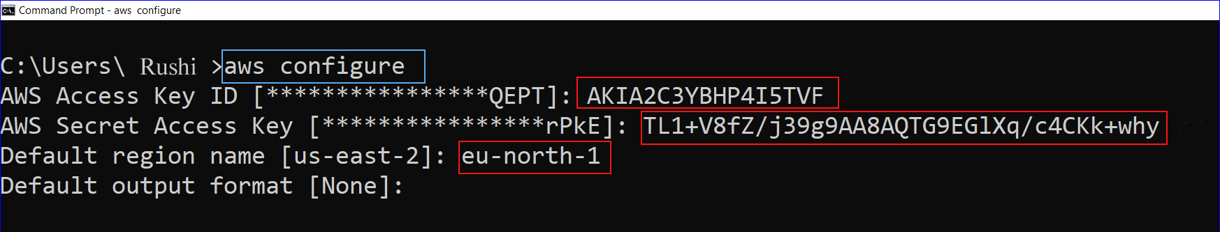
Programmatic Access

Slide 7
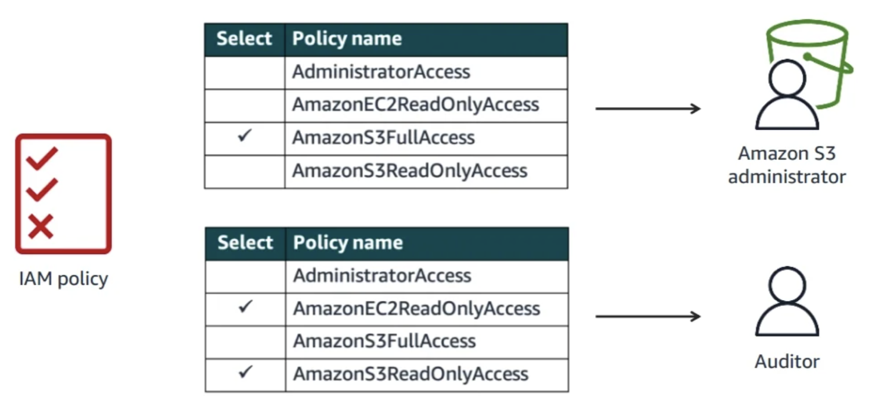
Setting Permissions with IAM Policies

Slide 8
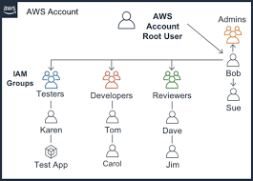
IAM User Groups
IAM Users are assigned to IAM User Groups.
Policies can be attached to IAM User Groups so that it can be applied to all IAM Users within the group.

Slide 9
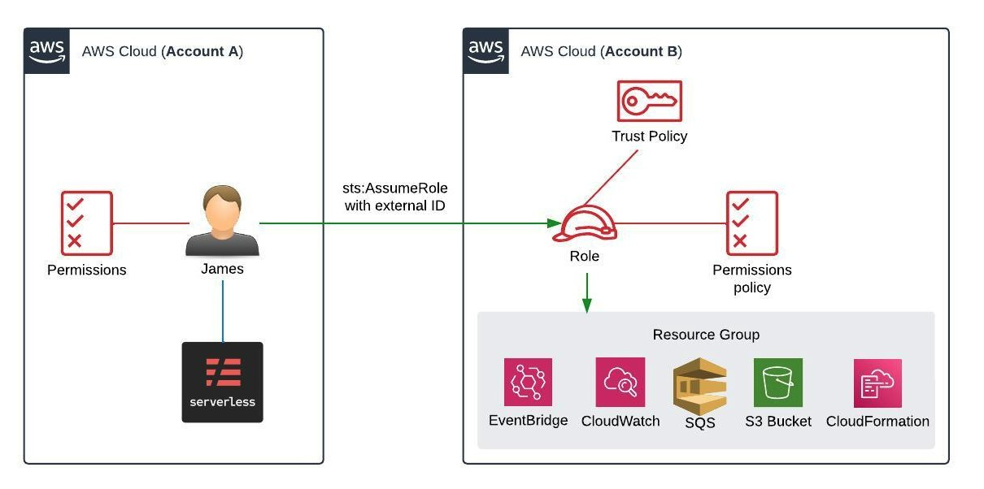
IAM Roles
Set of permissions can be given to specific users or services.
The role is assumed without credentials so that the permissions can be valid.

Slide 10
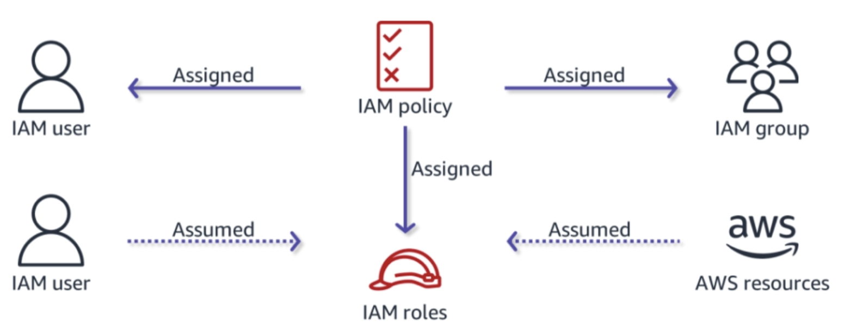
IAM Policy Assignment

Slide 11
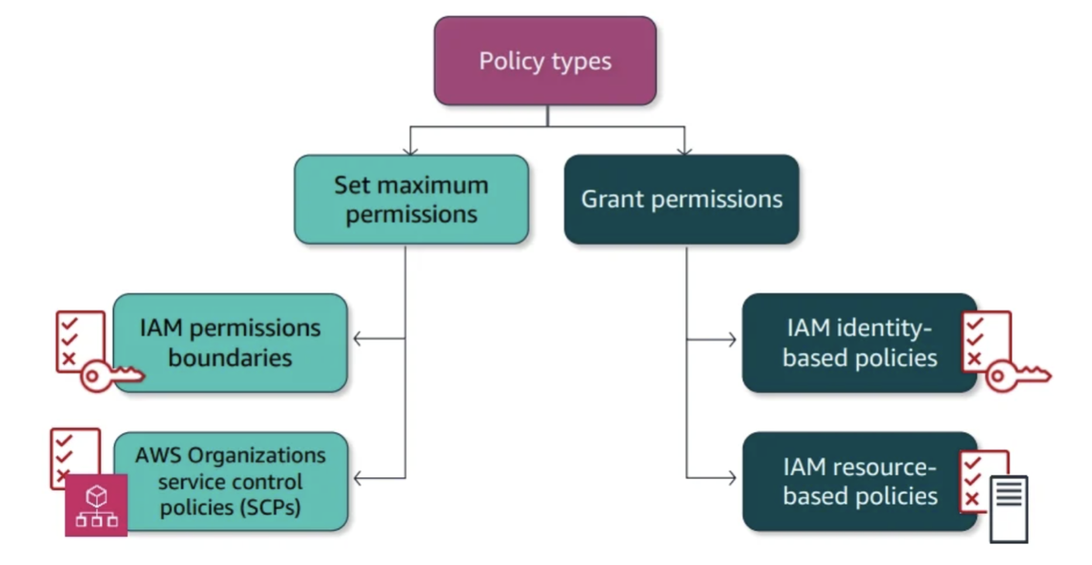
Security Policy Categories
Identity-based policies are assigned to users, groups and roles.
Resource-based policies are assigned to resources and they are checked when someone tries to access the resource.
IAM Permission Boundaries limit the user’s permissions.

Slide 12
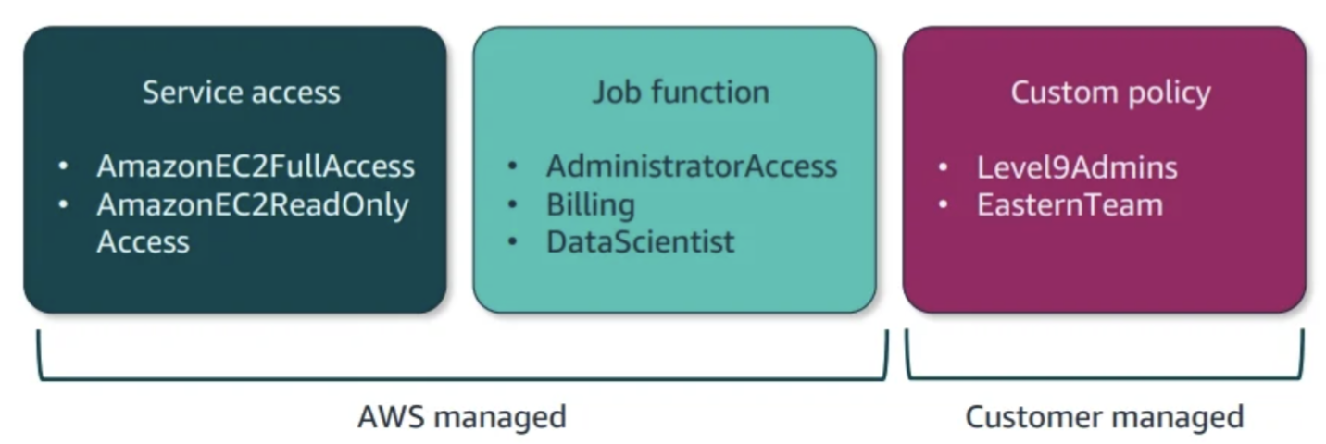
Identity-Based Policy Types

Slide 13
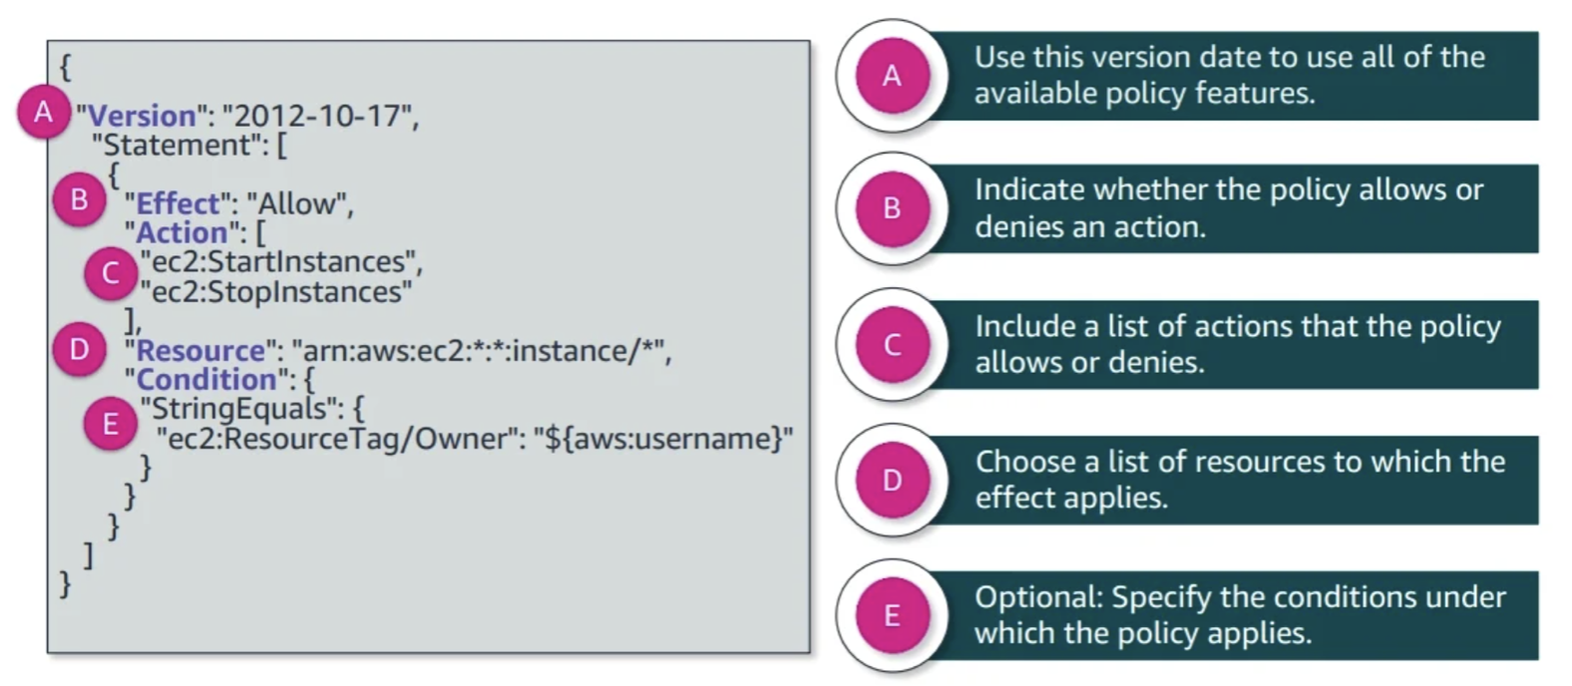
Identity-Based Policy Example

Slide 14
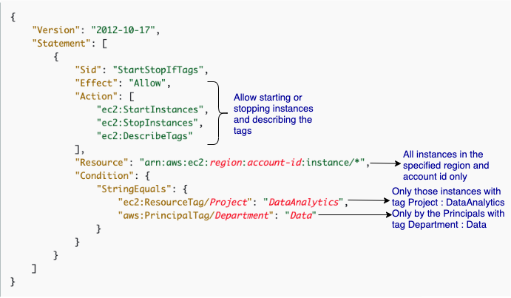
Resource-Based Policy Example

Slide 15
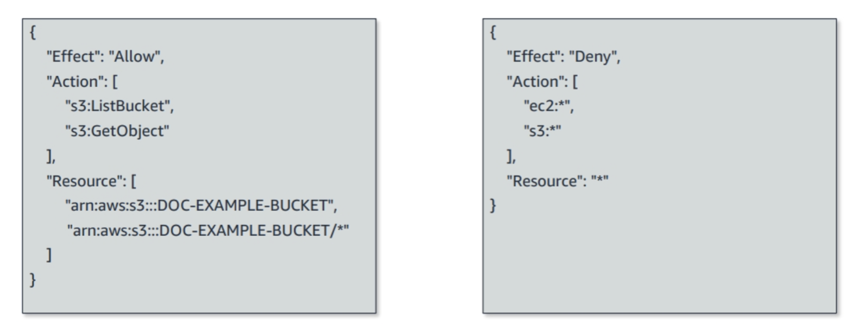
Explicit Allow and Explicit Deny

Slide 16
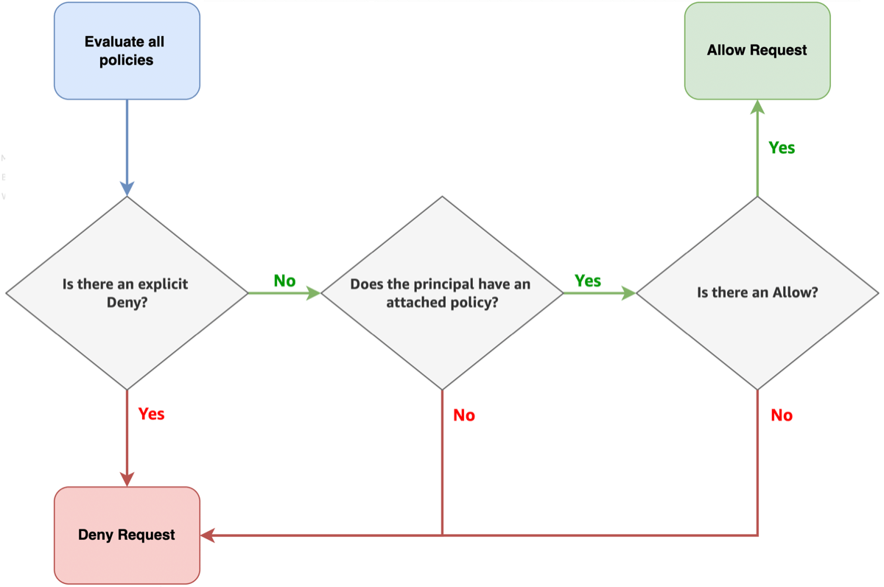
Policy Evaluation

Slide 17
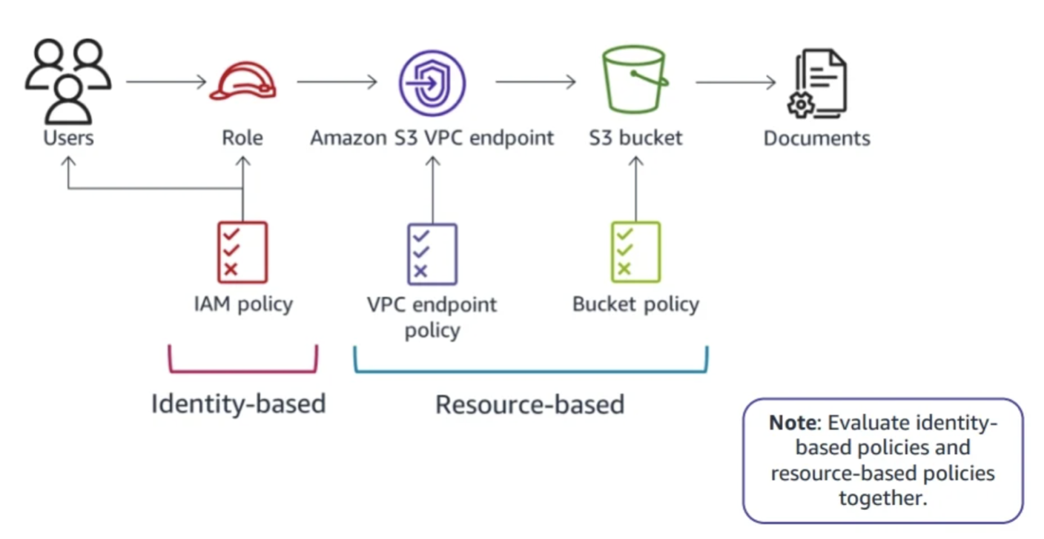
Architecture Tip

Slide 18
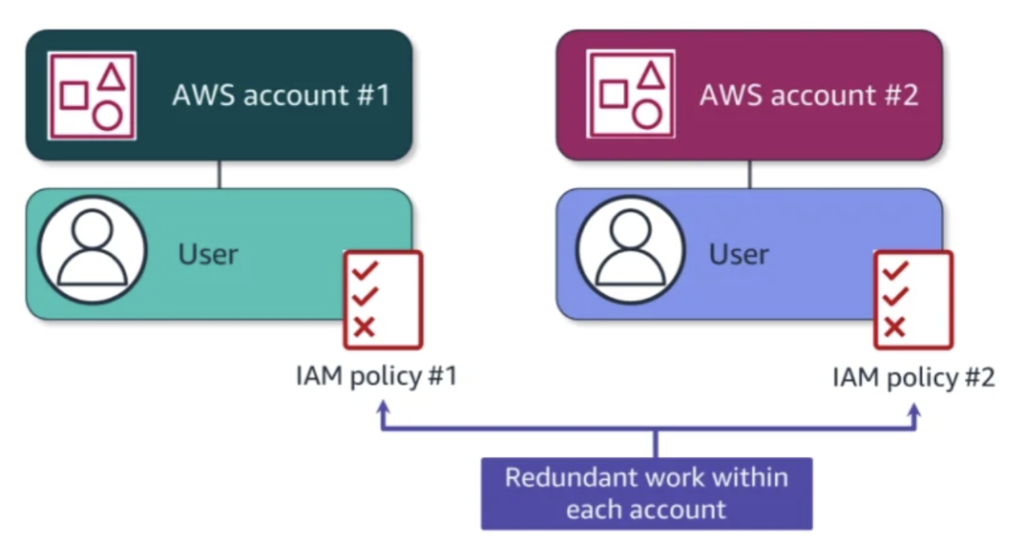
Without AWS Organizations
IAM Policies only apply to individual principals in a single account.
Policies must be managed in each account, resulting in generation of multiple bills.

Slide 19
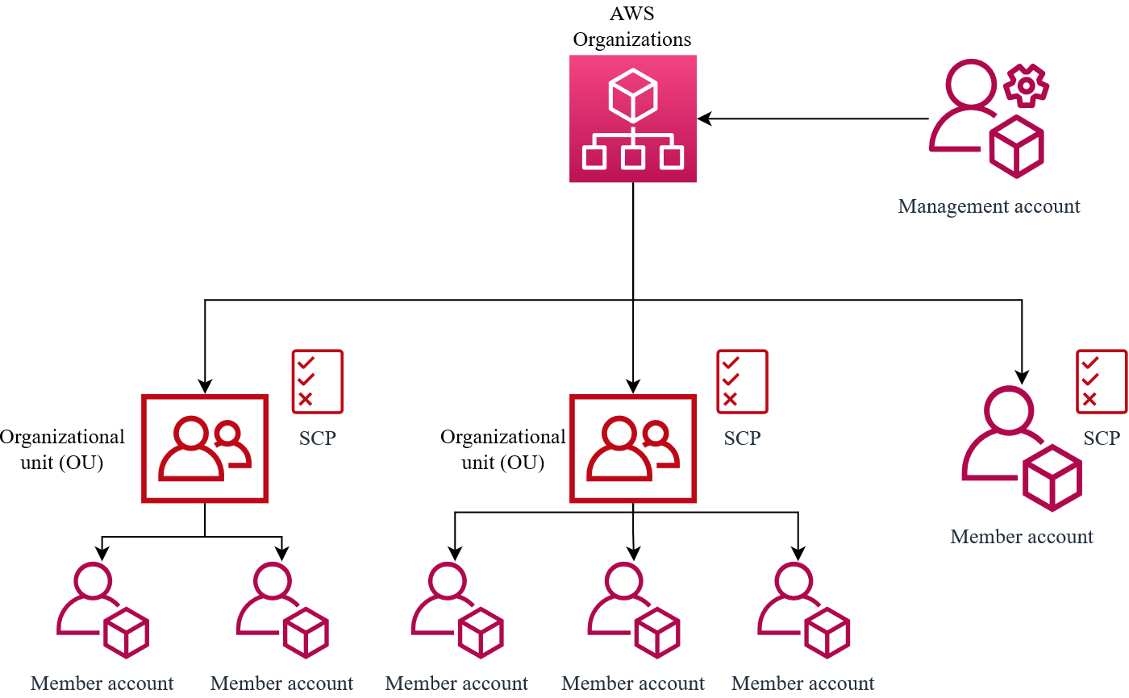
With AWS Organizations
Enable to develop multi-account strategy for business needs.
Create a hierarchy by grouping accounts into Organizational Units (OUs).
Service Control Policies (SCPs) control maximum permissions in every account under OUs.

Slide 20
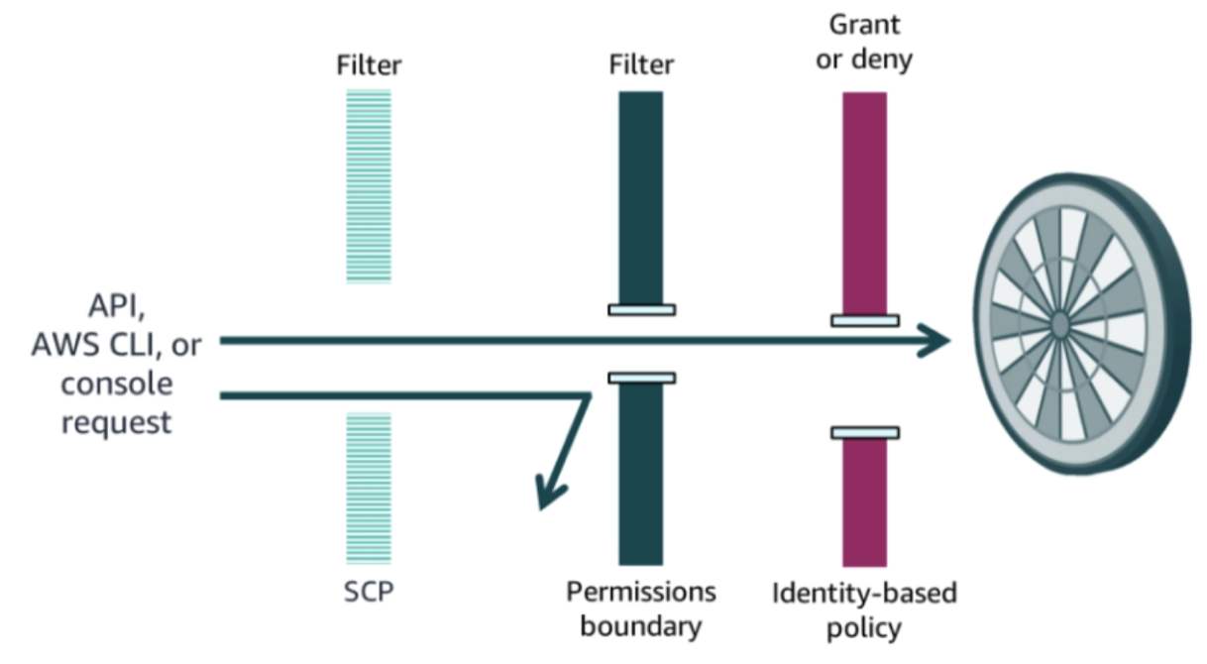
Layered Defense with Policies
SCPs don’t grant permissions, they only act as a filter!

Slide 21
THANKS FOR LISTENING

